Slide 1

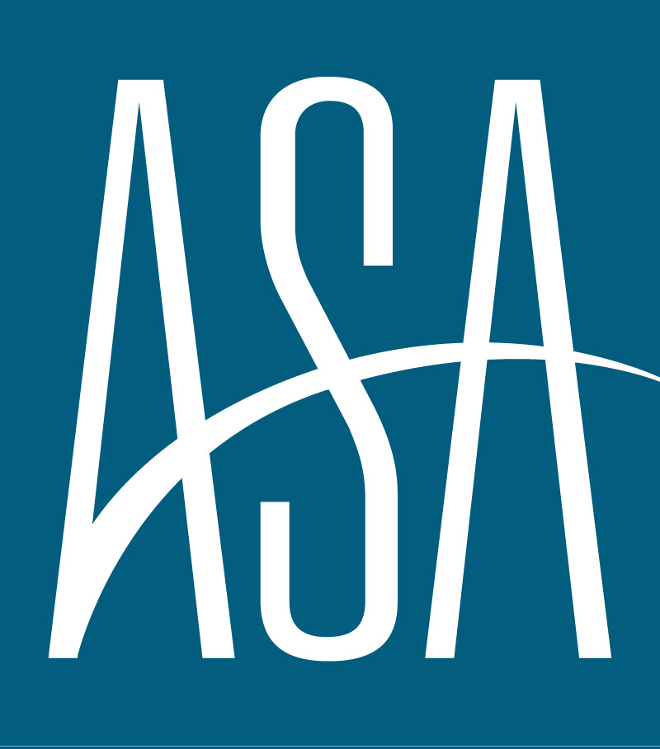
AMERICAN STAFFING ASSOCIATION
ECONOMIC & STAFFING FORECAST
AUGUST 2025

Slide 2




“A slowdown in labor demand under increased pressure from accelerating costs was always expected. The cadence of softening in labor churn is the real surprise, alongside a noticeable decoupling from broader economic growth.”
Noah Yosif
Chief Economist, American Staffing Association
EXECUTIVE SUMMARY
GDP
INFLATION
LABOR MARKET
STAFFING
GDP is expected to grow by 1.1 percent in 2025Q3 after rising by 3 percent in 2025Q2. Annual growth is expected to trend at 1.3 percent.
Core CPI and Core PCE are expected to rise by 3.3 percent and 3.5 percent year-over-year in 2025Q3, respectively.
The Unemployment Rate is expected to tick up to 4.4 percent in 2025Q3, up from 4.2 percent in 2025Q2.
Staffing Employment declined by 4 percent in 2025Q2, up from 5.6 percent in 2025Q1. It is expected to weather another decline of 2.9 percent in 2025Q3.

Slide 3
GDP
Following the normalization of trade imbalances which drove swings in economic activity over the first half of 2025, we expect GDP to moderate at 1.1 percent in 2025Q3. This reflects a combination of reduced, yet resilient, household consumption coupled with further declines in business investment. Economic activity is expected to remain healthy due to increases in productivity and labor market stability, rather than growth within the latter.

Slide 4
INFLATION
Core inflation is forecasted to modestly appreciate in the latter half of 2025, with CPI and PCE rising by 3.3 percent and 3.5 percent in 2025Q3, respectively. The uptick is still expected to be modest as the most severe tariffs remain suspended and additional trade deals are secured. However, should tariffs remain a staple within US trade policy long-term, inflation could maintain its upward trajectory. We also expect the Federal Reserve to stand by its forward guidance and reduce interest rates by 50 basis points in 2025.

Slide 5
LABOR MARKET
Revisions to recent labor market numbers suggest an increased cadence of cooling than originally expected. We believe nonfarm payroll growth will hold at just 0.2 percent for the remainder of 2025, as cost pressures remain far from abated and employers suspend personnel decisions amid heightened economic uncertainty. With risks still shifted towards employees, we see further softening in labor demand driving the unemployment rate to 4.4 percent.

Slide 6
STAFFING EMPLOYMENT
An increased cadence of cooling in labor market churn suggests a slower recovery for staffing employment, with growth expected to decline by 2.9 percent and 0.9 percent in 2025Q3 and 2025Q4, respectively. Light Industrials remains a drag on industry employment owing to elevated production and borrowing costs, while gains will continue to be driven by Healthcare owing to persistent personnel shortages within the sector.

Slide 7




Methodology
The ASA Economic & Staffing Forecast synthesizes monthly data to generate real-time predictions about the current state of the economy. It is based on a dynamic factor model using principal components analysis and Bayesian estimation techniques.
ASA Research Department
Noah Yosif
Chief Economist
Tim Hulley
Disclaimer
Associate Director of Research
Analyses, estimates, forecasts, opinions, and other views contained within this document herein belong to the ASA Research Department. While the ASA Research Department uses many assumptions to ensure the accuracy of all analyses, estimates, forecasts, and opinions, they are not intended for any specific purpose, and any projected outcomes are not guaranteed, Changes in underlying assumptions, as well as incoming data, may foster materially different results. The analyses, estimates, forecasts, and opinions of the ASA Research Department represent those to-date, and do not necessarily reflect the views of ASA management, staff, members, and/or affiliated organizations.
Maxwell Aldrich
Research Coordinator

