Slide 1

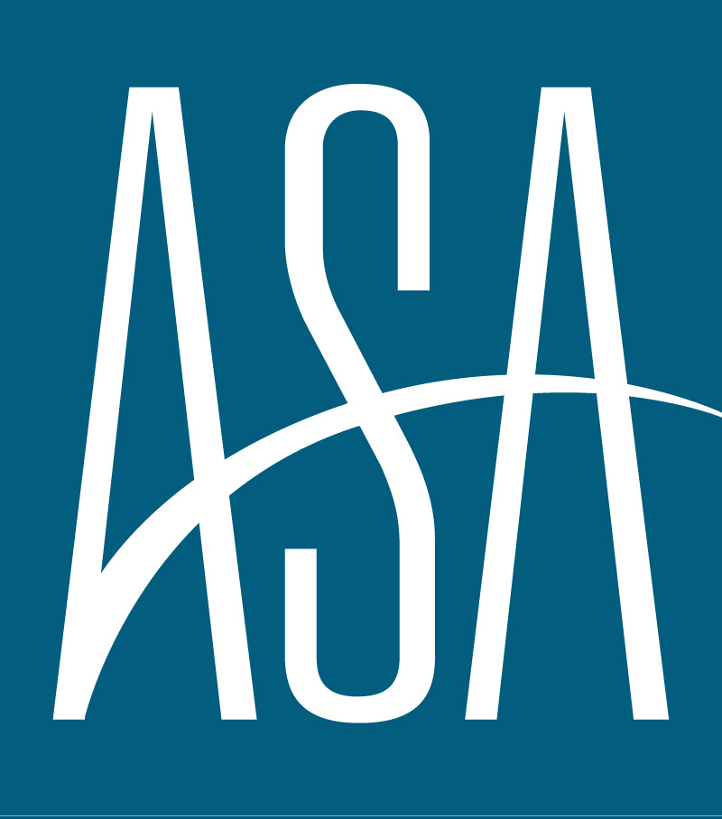
AMERICAN STAFFING ASSOCIATION
ECONOMIC & STAFFING FORECAST
SEPTEMBER 2025

Slide 2




“An accelerated cooldown in labor market activity will be a mild delay to the recovery in staffing employment until changes in monetary and fiscal policy have an opportunity to filter their way throughout the economy.”
Noah Yosif
Chief Economist, American Staffing Association
EXECUTIVE SUMMARY
GDP
INFLATION
LABOR MARKET
STAFFING
GDP is expected to grow by 0.4 percent in 2025Q3 while annual growth is expected to trend at 1.0 percent.
Core CPI and Core PCE are expected to rise by 3.3 percent and 3.5 percent year-over-year in 2025Q3, respectively.
The Unemployment Rate is expected to tick up to 4.4 percent in 2025Q3, up from 4.2 percent in 2025Q2.
Staffing Employment is expected to realize declines for the rest of the year: 2.5 percent in 2025Q3 and -0.9 percent in 2025Q4.

Slide 3
GDP
Economic activity will likely decline to 0.4 percent in 2025Q3 owing to weakness in consumption driven by the slowdown in labor market activity. Unlike previous quarters where consumption offset declines in business investment and government spending, the slowdown in 2025Q3 will likely be more severe given the importance of household spending. The extent of this downturn will depend on the extent of instability within the labor market.

Slide 4
INFLATION
Core inflation is still expected to rise modestly in 2025Q3, with Core CPI and Core PCE accelerating by 3.3 and 3.5 percent respectively. These trends affirm claims that tariffs will likely yield a one-off increase in prices rather than sustained inflation. This would enable the Federal Reserve to pivot its attention towards the labor market, which will likely yield at least two cuts to its benchmark interest rate in 2025, to take effect by 2026Q1.

Slide 5
LABOR MARKET
The ongoing deceleration in labor market activity is mostly driven by a lack of new jobs being created and hiring for those roles, yielding nonfarm payroll growth of 0.5 percent in 2025Q3. This means that the labor market can no longer accommodate everyone who is seeking work. Conversely, unemployment remains at a healthy level, but trending in an unhealthy direction and will likely rise to 4.4 percent in 2025Q3, before peaking at 4.5 percent by 2025Q4.

Slide 6
STAFFING EMPLOYMENT
A continued depression in labor churn will likely sustain attrition in staffing employment, driving an expected 2.5 percent decline in 2025Q3 and further 0.9 percent decline in 2025Q4. Light industrials is expected to bear the brunt of labor market instability and constitute the largest drag on industry employment. Pockets of growth remain in select segments of the labor market; especially high-skilled services, which will likely offset further declines in staffing employment for the rest of the year.

Slide 7




Methodology
The ASA Economic & Staffing Forecast synthesizes monthly data to generate real-time predictions about the current state of the economy. It is based on a dynamic factor model using principal components analysis and Bayesian estimation techniques.
ASA Research Department
Noah Yosif
Chief Economist
Tim Hulley
Disclaimer
Associate Director of Research
Analyses, estimates, forecasts, opinions, and other views contained within this document herein belong to the ASA Research Department. While the ASA Research Department uses many assumptions to ensure the accuracy of all analyses, estimates, forecasts, and opinions, they are not intended for any specific purpose, and any projected outcomes are not guaranteed, Changes in underlying assumptions, as well as incoming data, may foster materially different results. The analyses, estimates, forecasts, and opinions of the ASA Research Department represent those to-date, and do not necessarily reflect the views of ASA management, staff, members, and/or affiliated organizations.
Maxwell Aldrich
Research Coordinator

